Slide 1
Golden House

Slide 2

Overview
Who We Are/Mission
Dynamics of Domestic Abuse
History of Golden House
Golden House Services
Ways to Get Involved

Slide 3
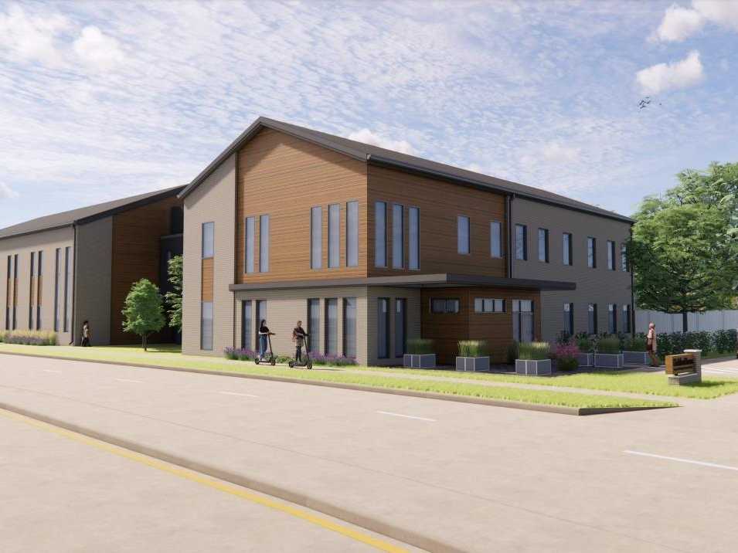
Who We Are
Golden House is a comprehensive program that serves all victims of domestic violence.

Slide 4
Our Mission
The mission of Golden House is to provide safety and support for victims of domestic abuse, while leading efforts to end domestic violence in our community.

Slide 5
The Facts:
1 in 4 women, and 1 in 7 men experience domestic violence in their lifetime.
Every 60 seconds about 23 people are physically abused by a partner in the US
72% of all murder-suicides involve an intimate partner; 94% of the victims of these murder suicides are female.
Wisconsin currently ranks 7th in the U.S. for domestic violence related homicides.
In 2023, 85 lives were lost due to domestic violence in WI
Average rate of 1 life every 4.3 days

Slide 6
What is Domestic Violence?
A pattern of behaviors used by one partner to maintain power and control over another partner in an intimate relationship.
Forms
Physical, sexual, emotional, financial, digital, etc
May have multiple forms of abuse
DV doesn’t discriminate
All races, ages, genders, sexualities, and economic statuses can be victims or perpetrators

Slide 7
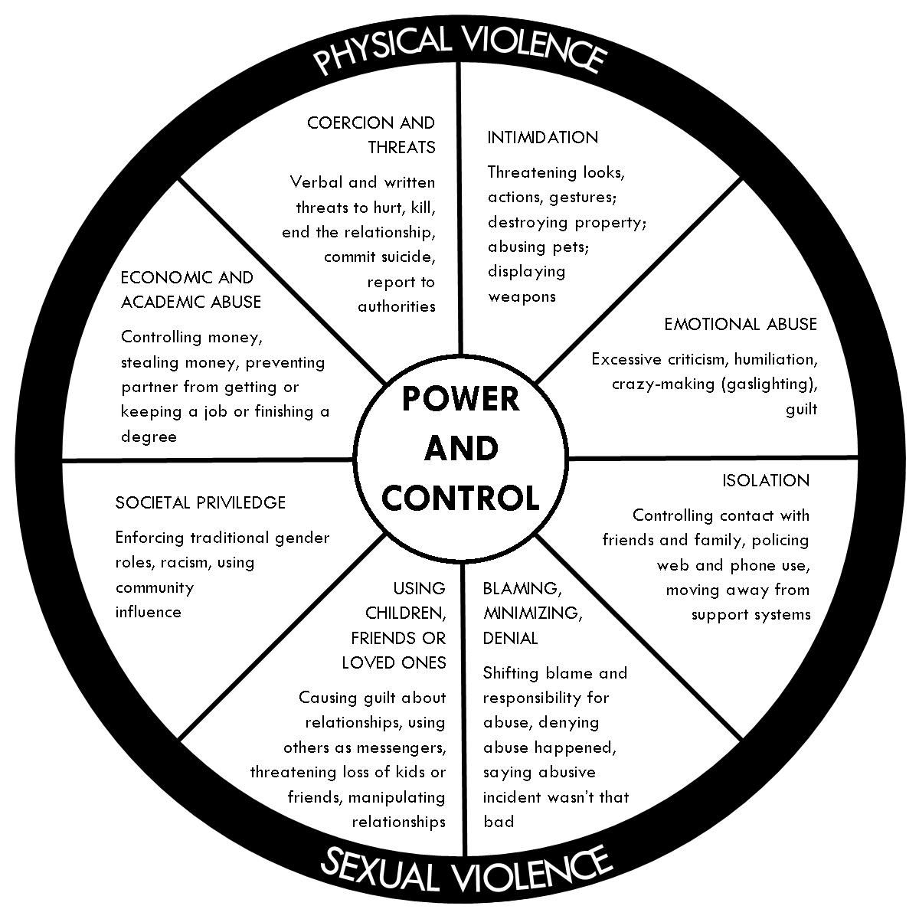
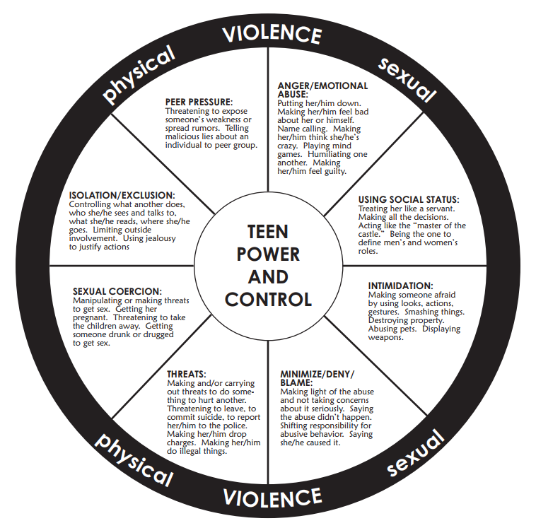

Slide 8

Cycle of Violence
Tension starts to build
Minor incidents begin
Breakdown of communication
Victim feels need to please abuser
Victim feels like they are ‘walking on eggshells’
Tension becomes unbearable
Stage 1: Tension Building
Abuser apologizes for behavior
Promises it will never happen again and that things will change OR denies abuse took place
Victim hopes that the abuse is over
Stage 3: Honeymoon
Period of explosive violence
Abuse occurs (physical,
sexual, emotional, digital, financial, etc)
Stage 2: Eruption

Slide 9
Why doesn’t the victim just leave?
Fear is the #1 reason partners stay in their abusive relationship
Fear Of:
Retaliation/Increased Abuse
Loneliness/Independence
Not being believed
Leaving/Change
Traumatizing Children
Financial Instability
Housing Insecurity
Police Involvement
Emotional Factors
Guilt/Shame
Exhaustion/Confusion
Depression/Numbness
Need to feel needed
Feels responsible to him/her or for him/her
Sympathy for him/her
Love him/her, but angry for how they are being treated.

Slide 10

Recognizing Signs of Domestic Violence

Slide 11
Characteristics of Victims
Isolated/distanced from friends
Unusually quiet or withdrawn
Apprehension to speak in front of partner
Acts differently when their partner is nearby
Physical marks/bruising
Clothing changes
Dropping out of activities that usually interest them
Excusing/minimizing abusive behavior
Personality changes
Easily startled
Unhealthy coping mechanisms

Slide 12
Red Flags in an Abuser
Abuser speaking for the victim
Not allowing victim to meet with the person/doctor alone
Arriving late to appointments (the abuser may sabotage appointments on purpose)
Agitated, nervous, pacing (in waiting room, exam room, ER)
Downplaying an injury (“he/she accidently fell off the ladder” / “it isn’t as bad as he/she thinks it is”)
Very nice, professional
Alcohol and drug abuse

Slide 13
Red Flags in an Abuser
Prior violent or abuse behavior
Wanting control over financial matters
Holding rigid, traditional views of sex roles and parenting, or negative attitudes towards partner
Showing extreme jealousy and possessiveness, which leads to isolation
Physical abuse during courtship
Denying the abuse, minimizing the seriousness of the abuse, or refusing to take responsibility

Slide 14
Clinical Signs of Domestic Abuse
Bruises, bites, burns, lacerations, abrasions, head injuries and skeletal injuries are some of the common forms of domestic violence trauma
Injuries that point to a defensive position over the face (bruises and marks on the inside of the arms, back)
Injuries to the chest and stomach
The illness or injuries do not match the cause given
Delay in requesting medical care
Injuries and bruises of various colors, indicating injuries occurring regularly over a period of time

Slide 15
Clinical Signs of Domestic Abuse
Repeat injuries, someone who is ‘accident prone’
Injuries during pregnancy
Repeated reproductive health problems: repeat miscarriage, early delivery, sexually transmitted diseases
Psychological or behavioral problems
Suicide attempts or signs of depression
Repeat and chronic medical complaints, pelvic problems and pains, psychological diseases

Slide 16
Potential Health Effects
Intimate partner violence has long-term negative health consequences for survivors, even after the abuse has ended. These effects can manifest as poor health status, poor quality of life, and high use of health service
Examples:
Chronic health problems such as chronic pain (eg, headaches, back pain) or recurring central nervous system symptoms including fainting and seizures
Gastrointestinal symptoms (eg, loss of appetite, eating disorders) and diagnosed functional gastrointestinal disorders (eg, chronic irritable bowel syndrome)
Cardiac symptoms such as hypertension and chest pain
Colds and influenza
Mental-health disorders such as depression
Depression and post-traumatic stress disorder, which have substantial comorbidity, are the most prevalent mental-health effects of intimate
partner violence

Slide 17
Neglect
Abuser may restrict partner from seeking medical care
As a result they may suffer from lack of care that medically endangers themselves
Sometimes medical neglect can be an indicator of a larger neglect problem

Slide 18
How Can YOU Help?
Most victims will not disclose abuse unless asked directly.
Ask if they’re feeling safe at home or in their relationship
Ask if you can connect them with an advocate from Golden House

Slide 19
How Can YOU Help?
Providing comfort can make the difference between fear and security, and can provide a foundation for resilience.
Help individuals know what to expect during the visit
Give them as much choice as possible and show them their opinions matter
Stay calm even when they aren’t
Be aware of how trauma may impact behavior and triggers
Recognize trauma reactions as a legitimate coping strategy

Slide 20
How Can YOU Help?
Interactive Resource Maps of WI
Wisconsin Domestic Violence Resources:
www.endabusewi.org
Wisconsin Sexual Assault Resources:
www.wcasa.org/service-providers

Slide 21
Golden House Services
Free and confidential for men, women, and children:
Advocacy
Crisis Advocates: Walk ins, calls, appointments, etc
Age appropriate safety planning
Resource referrals
Restraining/Harassment Order Assistance
Safe Home programming
Housing program application assistance
Primary Advocates: Residents
Legal Advocate: Criminal cases
Rapid Rehousing Program Case Managers
Notes:
Marissa

Slide 22
Golden House Services
Free and confidential for men, women, and children:
24-hour Helpline/Textline
Emergency Shelter
Arrest Response
Mental Health Therapy for adults and children
Support Groups
Outreach and Prevention School/Community Education

Slide 23
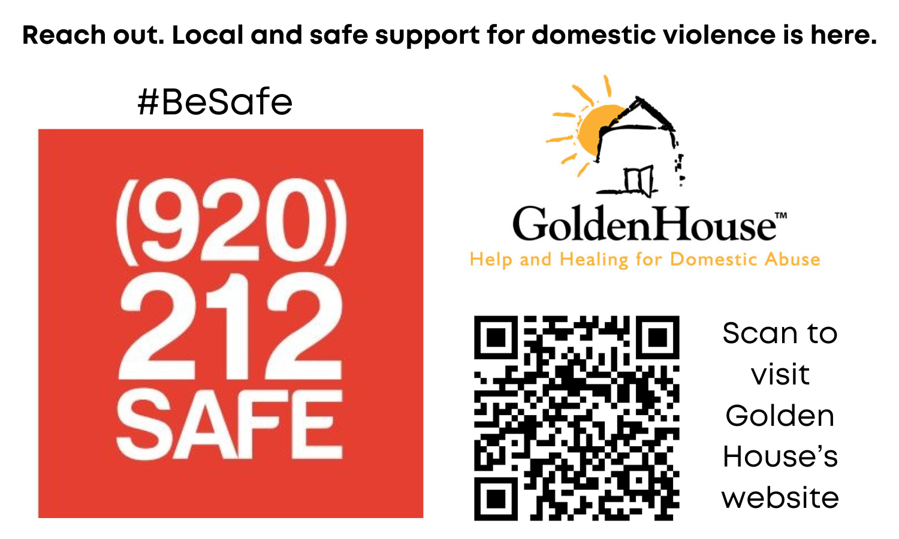

Location:
1120 University Ave.
Green Bay, WI 54302
920.435.0100 helpline
920.770.6415 textline
For more information please visit our website at www.goldenhousegb.org

